Slide 1
Final Project - YouTube Trending Videos Analytics & Performance Forecasting System
BY:
SRIMATHI K

Slide 2
Problem Statement
The objective of this project is to analyze YouTube trending video data to identify:
Factors that influence video performance,
Engagement patterns,
Trending behavior across different categories and countries.

Slide 3
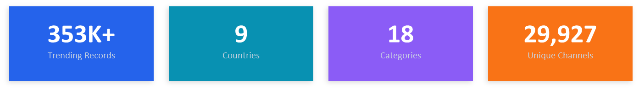
Dataset Overview
Dataset Source: Kaggle — YouTube Trending Video Statistics
Dataset Includes,
Video details
Views, likes, comments
Publish date and trending date
Multiple country datasets
Category mapping JSON files

Slide 4
Data Cleaning
Tasks Performed in Excel
Combined datasets from multiple countries
Checked and handled missing values
Standardized date and time formats
Cleaned and formatted text fields
Prepared structured data for SQL import
Additional Columns Created
Engagement Rate
Title Length
Tag Count
Publish Hour

Slide 5
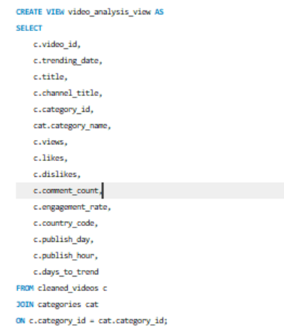
Category Mapping Integration
Extracted category details from JSON files
Converted JSON data into tabular format
Merged category names with the main dataset using category_id
Used SQL JOIN Query in order to Map the category name and id to the rest of the cleaned data.

Slide 6
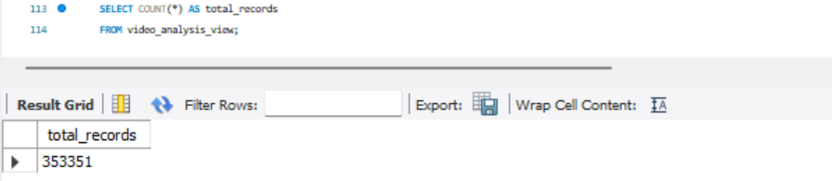
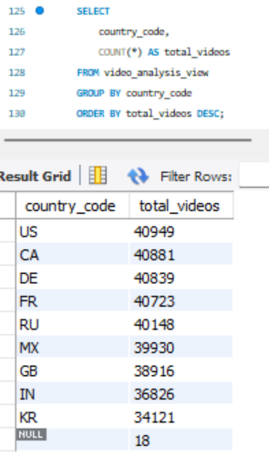
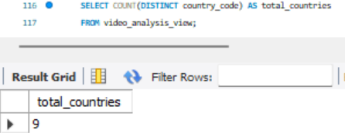
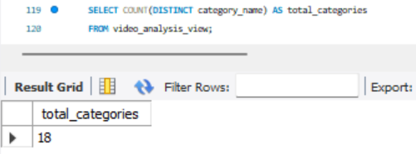
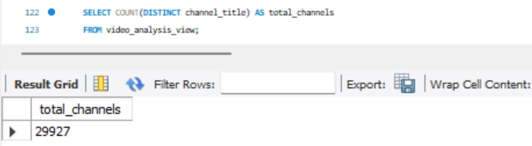
I) DATASET OVERVIEW ANALYSIS
Q1) Total Dataset Size
Q5) Country-wise Dataset Distribution
Q2) Total Countries Covered
Q3) Total Video Categories
Q4) Total Unique Channels

Slide 7
Dataset Overview
Key Findings from Queries - 1 to 5:
Dataset contains 353K+ trending video records.
Data collected from 9 countries.
Over 29K unique YouTube channels identified.
Dataset covers 18 video categories.
US has the highest trending video count.
The dataset is large and diverse enough for trend and engagement analysis.

Slide 8
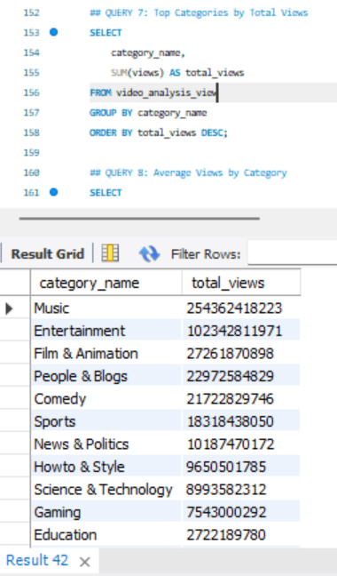
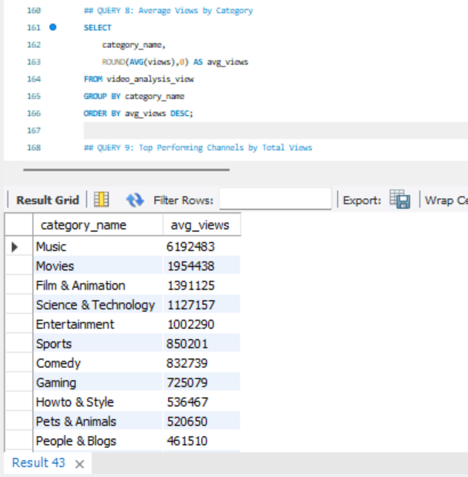
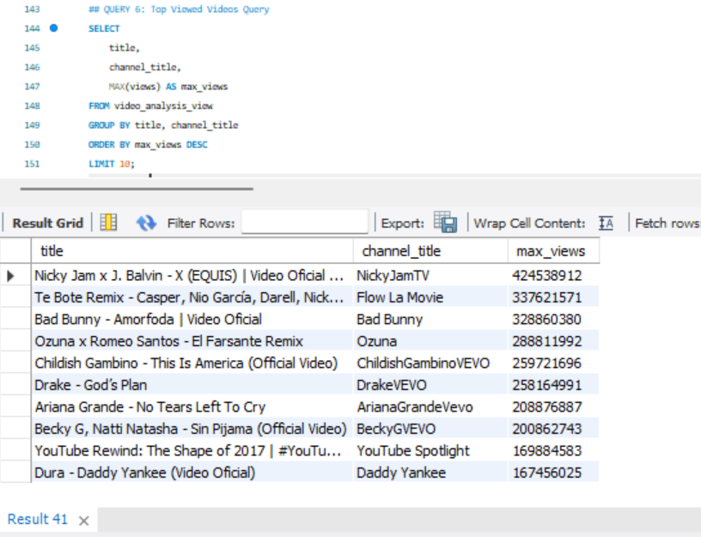
II) CONTENT PERFORMANCE ANALYSIS

Slide 9
Content Overview
Query 6 – Top Viewed Videos:
Music videos dominated trending views.
Viral songs maintained long-lasting popularity.
Entertainment content attracted massive reach.
Query 7 – Top Categories by Total Views:
Music led total views by a large margin.
Entertainment ranked second.
Educational content had lower reach.
Query 8 – Average Views by Category:
Music had the highest average views.
Movies and Film & Animation performed strongly.
Tech content showed solid audience interest.

Slide 10
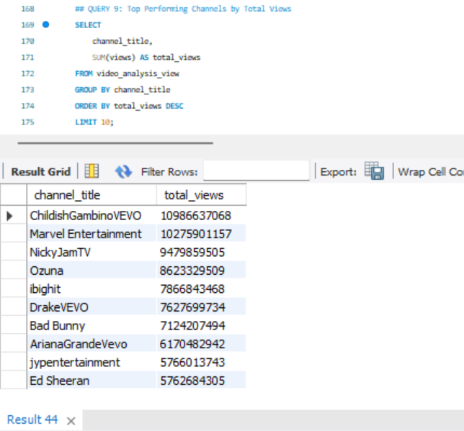
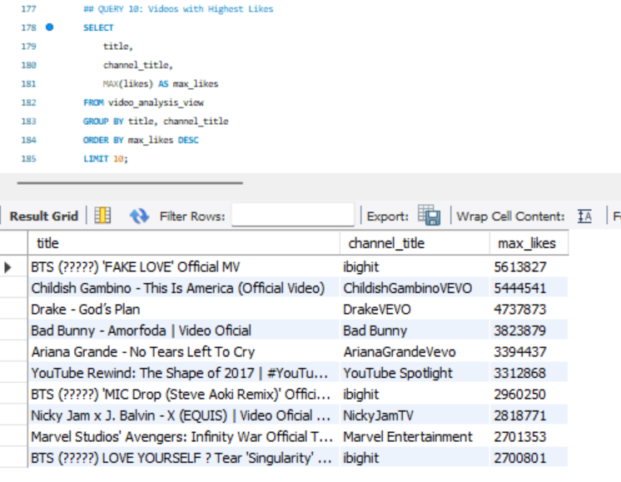
CONTENT PERFORMANCE ANALYSIS
Query 9 – Top Performing Channels
Music channels dominated overall visibility.
Artist and VEVO channels gained billions of views.
Major entertainment brands maintained strong reach.
Query 10 – Videos with Highest Likes
BTS and music artists received the most likes.
Fan-driven content generated high engagement.
Music videos outperformed most other categories.

Slide 11
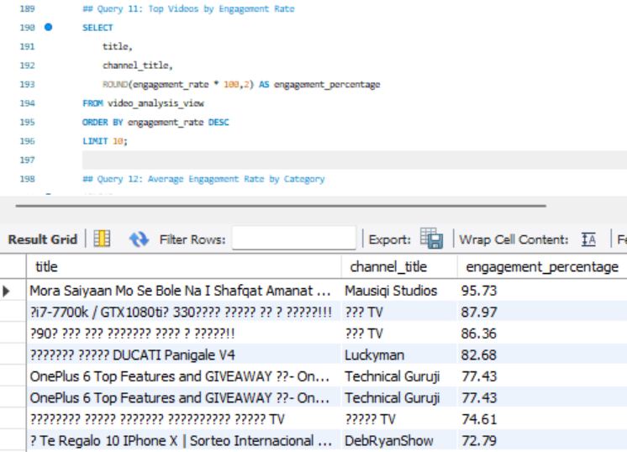
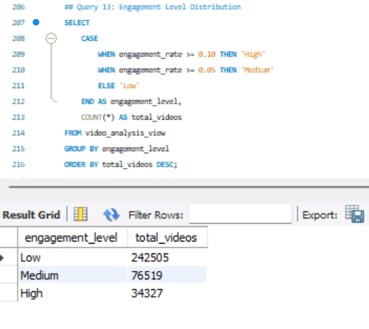
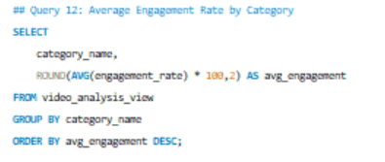
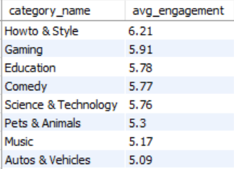
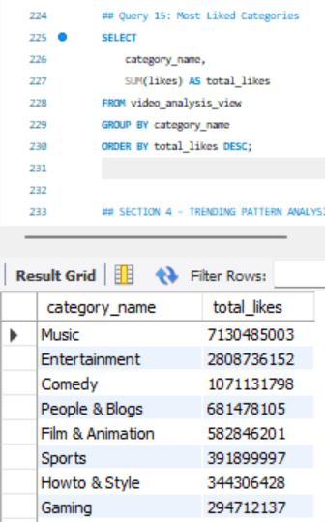
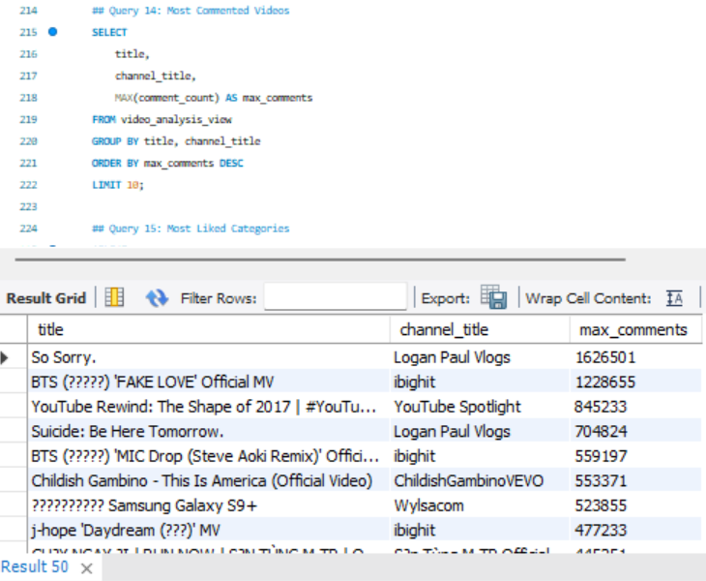
III) ENGAGEMENT ANALYSIS

Slide 12
Engagement Overview
Query 11 – Top Videos by Engagement Rate
Tech and regional videos showed very high engagement.
Strong audience loyalty drove interactions.
Query 12 – Average Engagement Rate by Category
Howto & Style had the highest engagement.
Gaming and Education performed strongly.
Query 13 – Engagement Level Distribution
Most videos had low engagement.
Only a small portion achieved high interaction.
Query 14 – Most Commented Videos
Music and viral videos received the most comments.
BTS and Logan Paul generated massive discussions.
Query 15 – Most Liked Categories
Music dominated total likes.
Entertainment and Comedy followed behind.

Slide 13
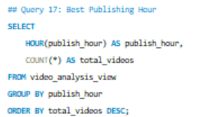
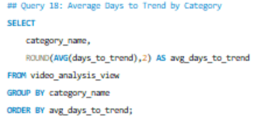
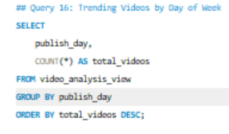
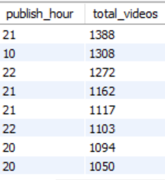
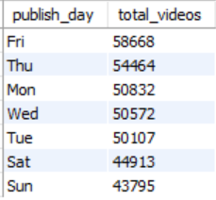
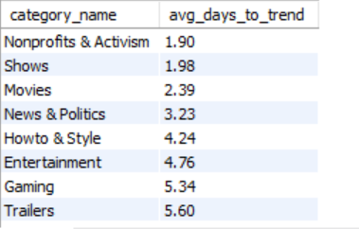
TRENDING PATTERN ANALYSIS

Slide 14
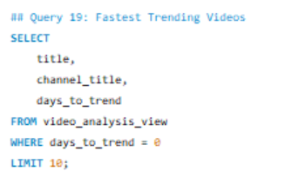
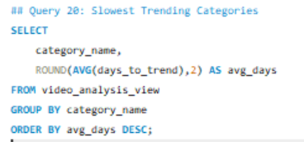
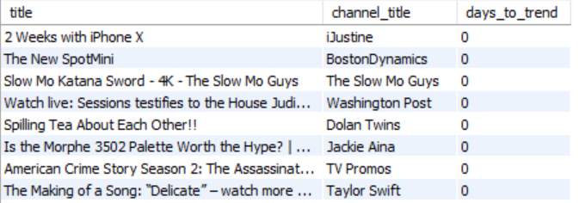
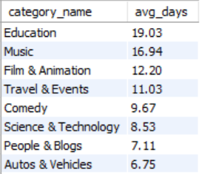
TRENDING PATTERN ANALYSIS

Slide 15
Trending Pattern Overview
Query 16 – Trending Videos by Day of Week
Friday had the highest trending activity.
Weekend uploads showed comparatively lower performance.
Weekday publishing was more effective overall.
Query 17 – Best Publishing Hour
Most trending videos were published during evening hours.
Peak activity was observed around 8 PM to 10 PM.
Query 18 – Average Days to Trend by Category
Nonprofits & Activism and News categories trended faster.
Gaming and Entertainment required slightly more time.
Query 19 – Fastest Trending Videos
Celebrity and tech-related videos trended immediately.
Strong audience interest accelerated visibility.
Query 20 – Slowest Trending Categories
Education took the longest time to trend.
Music and Film categories also needed sustained traction.

Slide 16
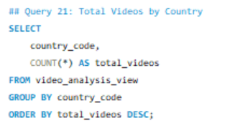
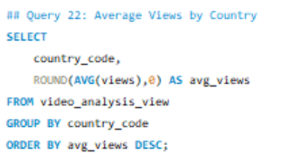
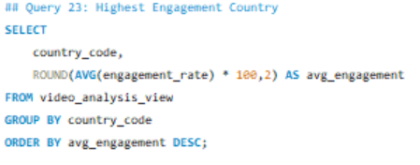
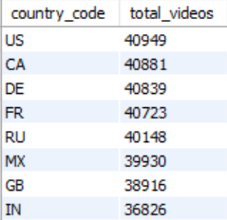
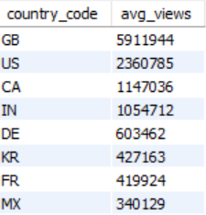
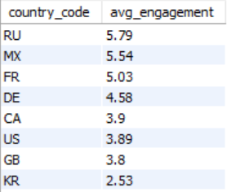
V) COUNTRY WISE ANALYSIS

Slide 17
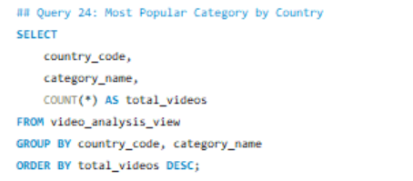
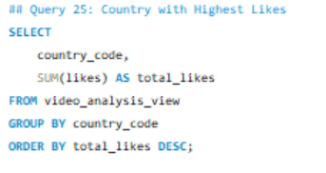
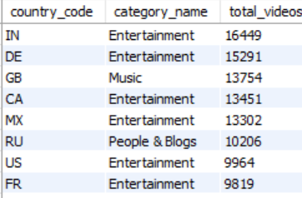
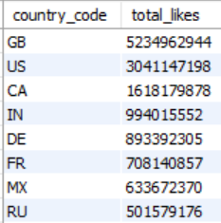
V) COUNTRY WISE ANALYSIS

Slide 18
Country Wise Overview
Query 21 – Total Videos by Country
US uploaded the highest number of trending videos.
Canada and Germany showed similar trending activity.
Trending content was concentrated across major global markets.
Query 22 – Average Views by Country
UK achieved the highest average views per video.
US and Canada maintained strong audience reach.
Indian content also showed high average visibility.
Query 23 – Highest Engagement Country
Russia recorded the strongest engagement rate.
Mexico and France also showed active audience interaction.
High engagement was not always linked to highest views.
Query 24 – Most Popular Category by Country
Entertainment dominated in most countries.
Music was especially popular in the UK.
Russia showed stronger preference for People & Blogs content.
Query 25 – Country with Highest Likes
UK generated the highest total likes.
US ranked second in audience appreciation.
Music-heavy regions showed stronger interaction levels.

Slide 19
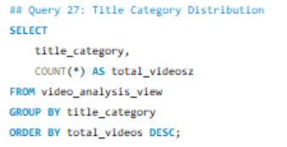
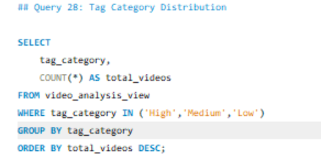
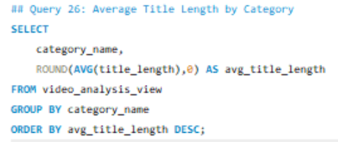
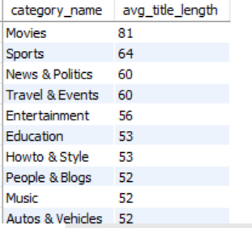
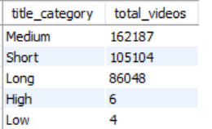
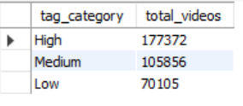
VI) TITLE & TAG ANALYSIS

Slide 20
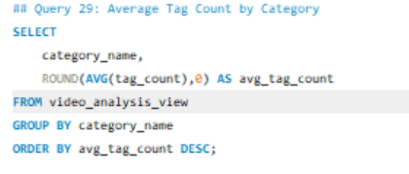
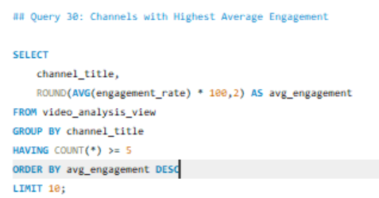
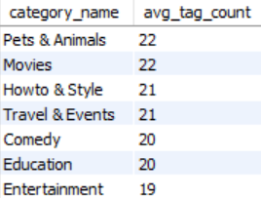
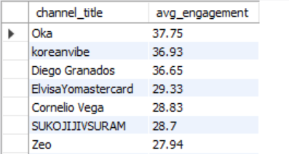
VI) TITLE & TAG ANALYSIS

Slide 21
Tag and Title Insights
Movie, Sports, and News videos used longer titles, likely to provide more context and attract clicks.
Medium-length titles performed best overall, suggesting balanced and readable titles gain more traction.
Videos with higher tag usage appeared more often in trending results, indicating better discoverability.
Pets & Animals, Movies, and Travel categories relied heavily on tags to improve search visibility.
Highly engaged channels were not always the biggest channels, showing that audience interaction matters more than size alone.

Slide 22
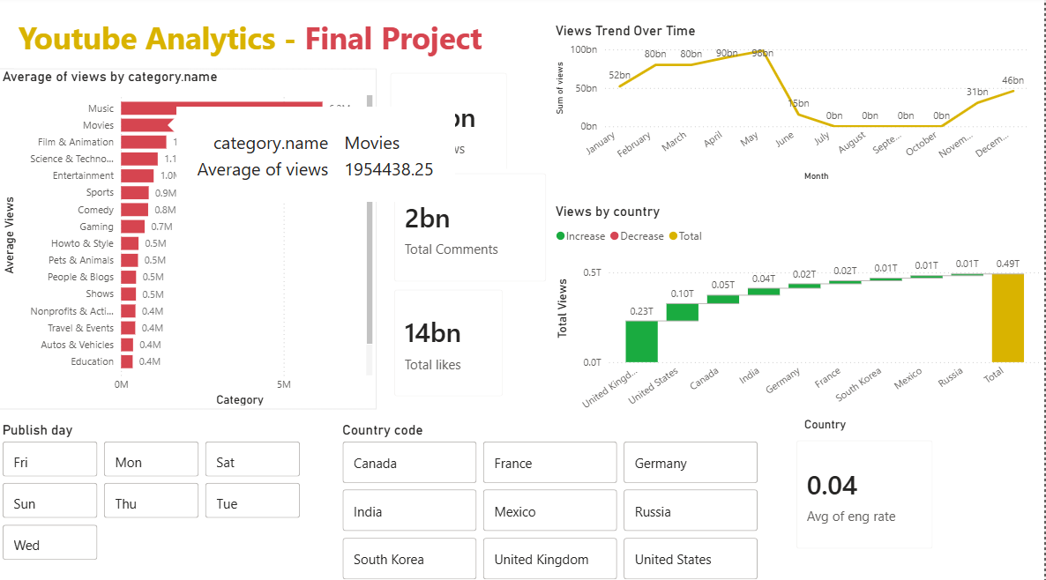
POWER BI ANALYSIS:
• The dataset contains approximately 492 billion views, 14 billion likes, and 2 billion comments, indicating massive audience activity across trending videos.
• Music, Movies, and Film & Animation categories generated the highest average views, making them the strongest-performing content segments.
• The United Kingdom and United States contributed the highest share of total views among analyzed countries.

Slide 23
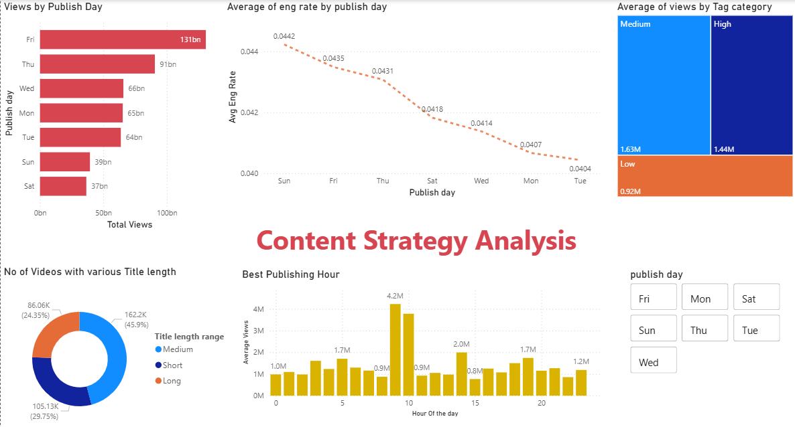
• Friday emerged as the best publishing day, generating the highest total video views among all weekdays.
• Videos published during peak evening and late-night hours achieved higher average view counts compared to other publishing times.
• Medium-length titles represented the largest proportion of trending videos, suggesting balanced title lengths improve discoverability.

Slide 24

• Nearly 69% of videos fall under the low-engagement category, while highly engaged videos constitute a smaller portion of the dataset.
• Videos with comments enabled achieved significantly higher engagement rates compared to videos with disabled comments.
• Categories such as How-to & Style, Gaming, and Education recorded the highest engagement rates, indicating stronger audience interaction.

Slide 25

• Most trending videos belong to the medium view-range bucket, showing that trending success is not limited to extremely viral videos.
• Trending activity peaks during specific publishing hours, highlighting the importance of publication timing in content visibility.
• A small number of videos account for exceptionally high view counts, with music and entertainment content dominating the top-performing positions.

Slide 26

Channel and Creator Analysis
• A limited number of channels contribute a significant share of total platform views, indicating creator concentration among top performers.
• Channels with higher average likes generally recorded higher comment activity, suggesting a positive relationship between audience appreciation and interaction.
• Certain creators consistently achieved higher engagement rates, demonstrating the importance of audience loyalty and content quality.

Slide 27
Overall Observations:
Music and Entertainment generate the highest views, making them the strongest categories for audience reach.
How-to & Style, Gaming, and Education achieve higher engagement despite lower overall views.
Publishing time significantly affects performance, with Thursday, Friday, and evening uploads performing best.
Videos with comments enabled show much higher engagement rates than those with comments disabled.
Russia and Mexico exhibit the highest engagement rates, indicating highly active audiences.
Medium-length titles and effective tag usage improve discoverability and trending potential.
Early audience response is critical, as successful videos tend to trend shortly after publication.

Slide 28

Actionable Recommendations:

